Slide 1

Danny's Diner: 8 Week SQL Challenge Case Study #1
A comprehensive data analysis journey exploring customer behavior, spending patterns, and loyalty program optimization through SQL queries

Slide 2

Introduction: Meet Danny's Diner
Specialty Cuisine
Authentic Japanese dishes: Sushi, Curry, and Ramen crafted with traditional techniques
Founded 2021
Danny's passion project brings Japanese culinary excellence to the neighborhood
Data-Driven Growth
Leveraging sales analytics to understand customers and build lasting loyalty

Slide 3
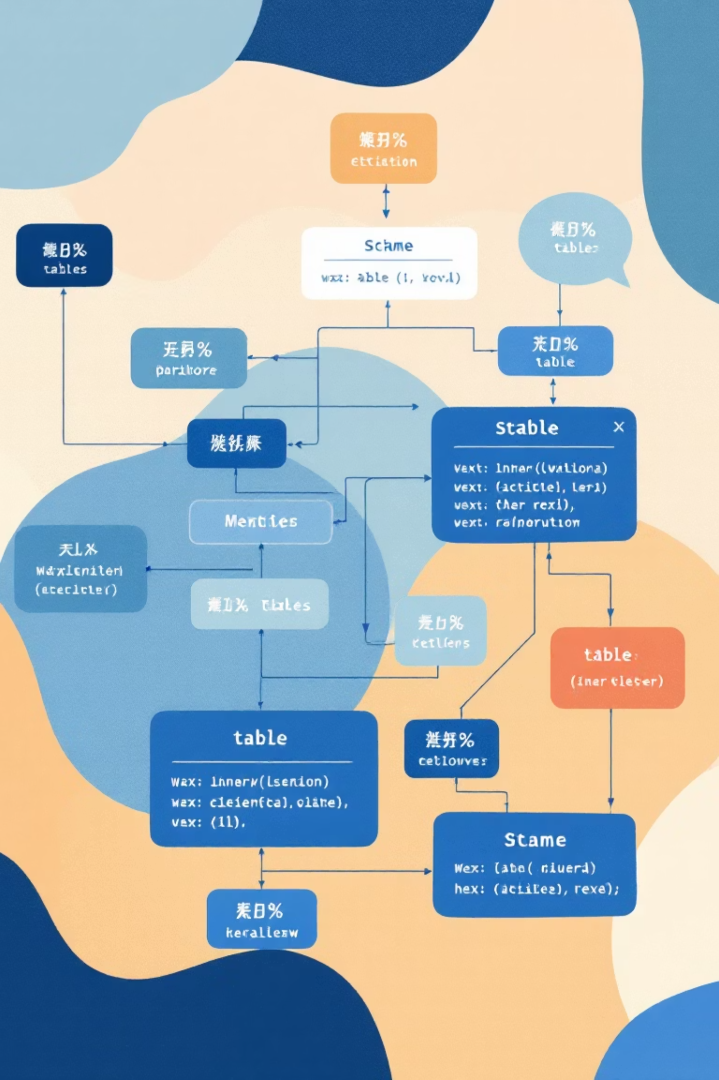
The Data: Three Key Tables
sales
menu
Transaction records capturing customer purchases by date and product_id - the heart of our analysis
Product catalog mapping product_id to product_name and price for comprehensive cost analysis
members
Loyalty program enrollment data tracking when customers joined for behavior comparison
All data housed in the dannys_diner database schema, ready for SQL exploration and insights extraction

Slide 4
Business Questions to Answer
Customer Value Analysis
How much does each customer spend to identify high-value diners?
Visit Patterns
How often do customers visit to understand engagement levels?
Menu Preferences
What are customers' favorite items to optimize inventory and promotions?
Loyalty Impact
How does membership affect purchasing behavior and frequency?
Rewards Strategy
How to design an effective points system that drives retention?

Slide 5
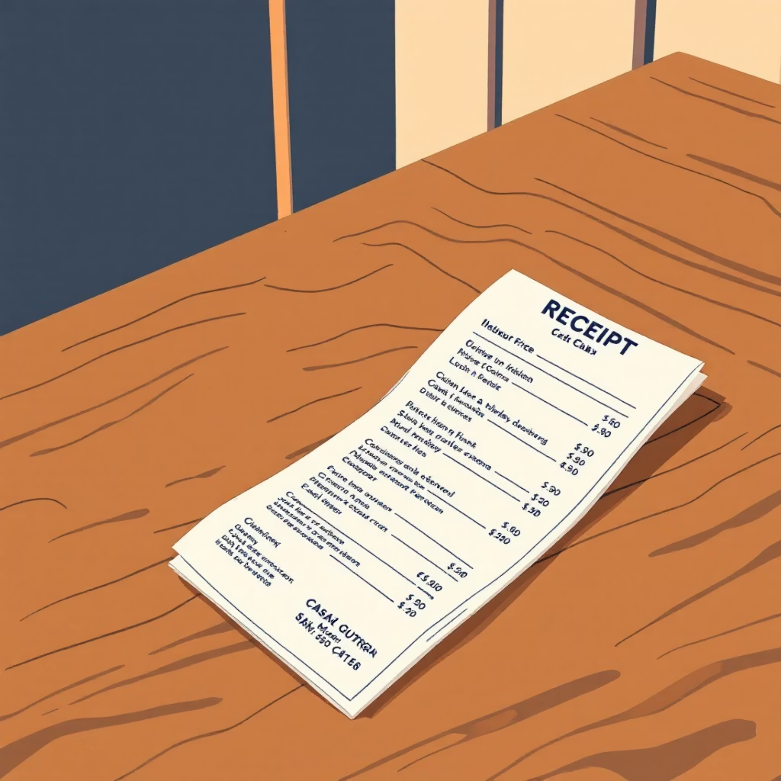
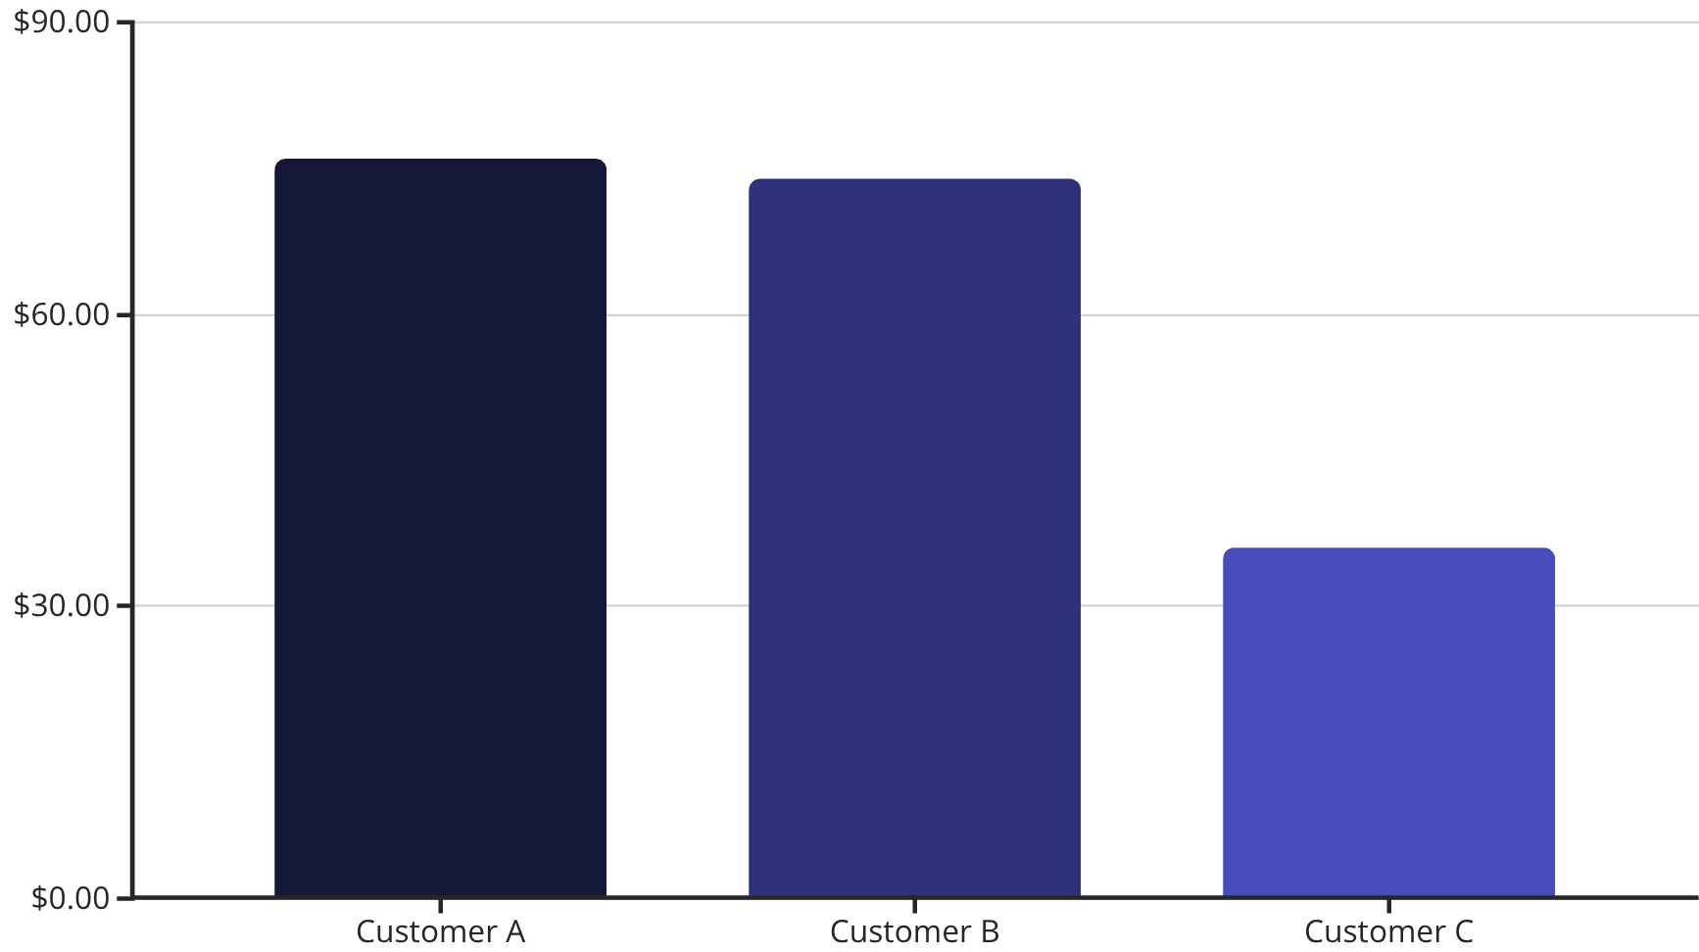

Total Spending Per Customer
SQL joins sales and menu tables, summing prices per customer to reveal spending patterns and identify valuable customers
Key Insight: Customers A and B represent high-value diners with spending over $70 each, significantly outpacing Customer C

Slide 6
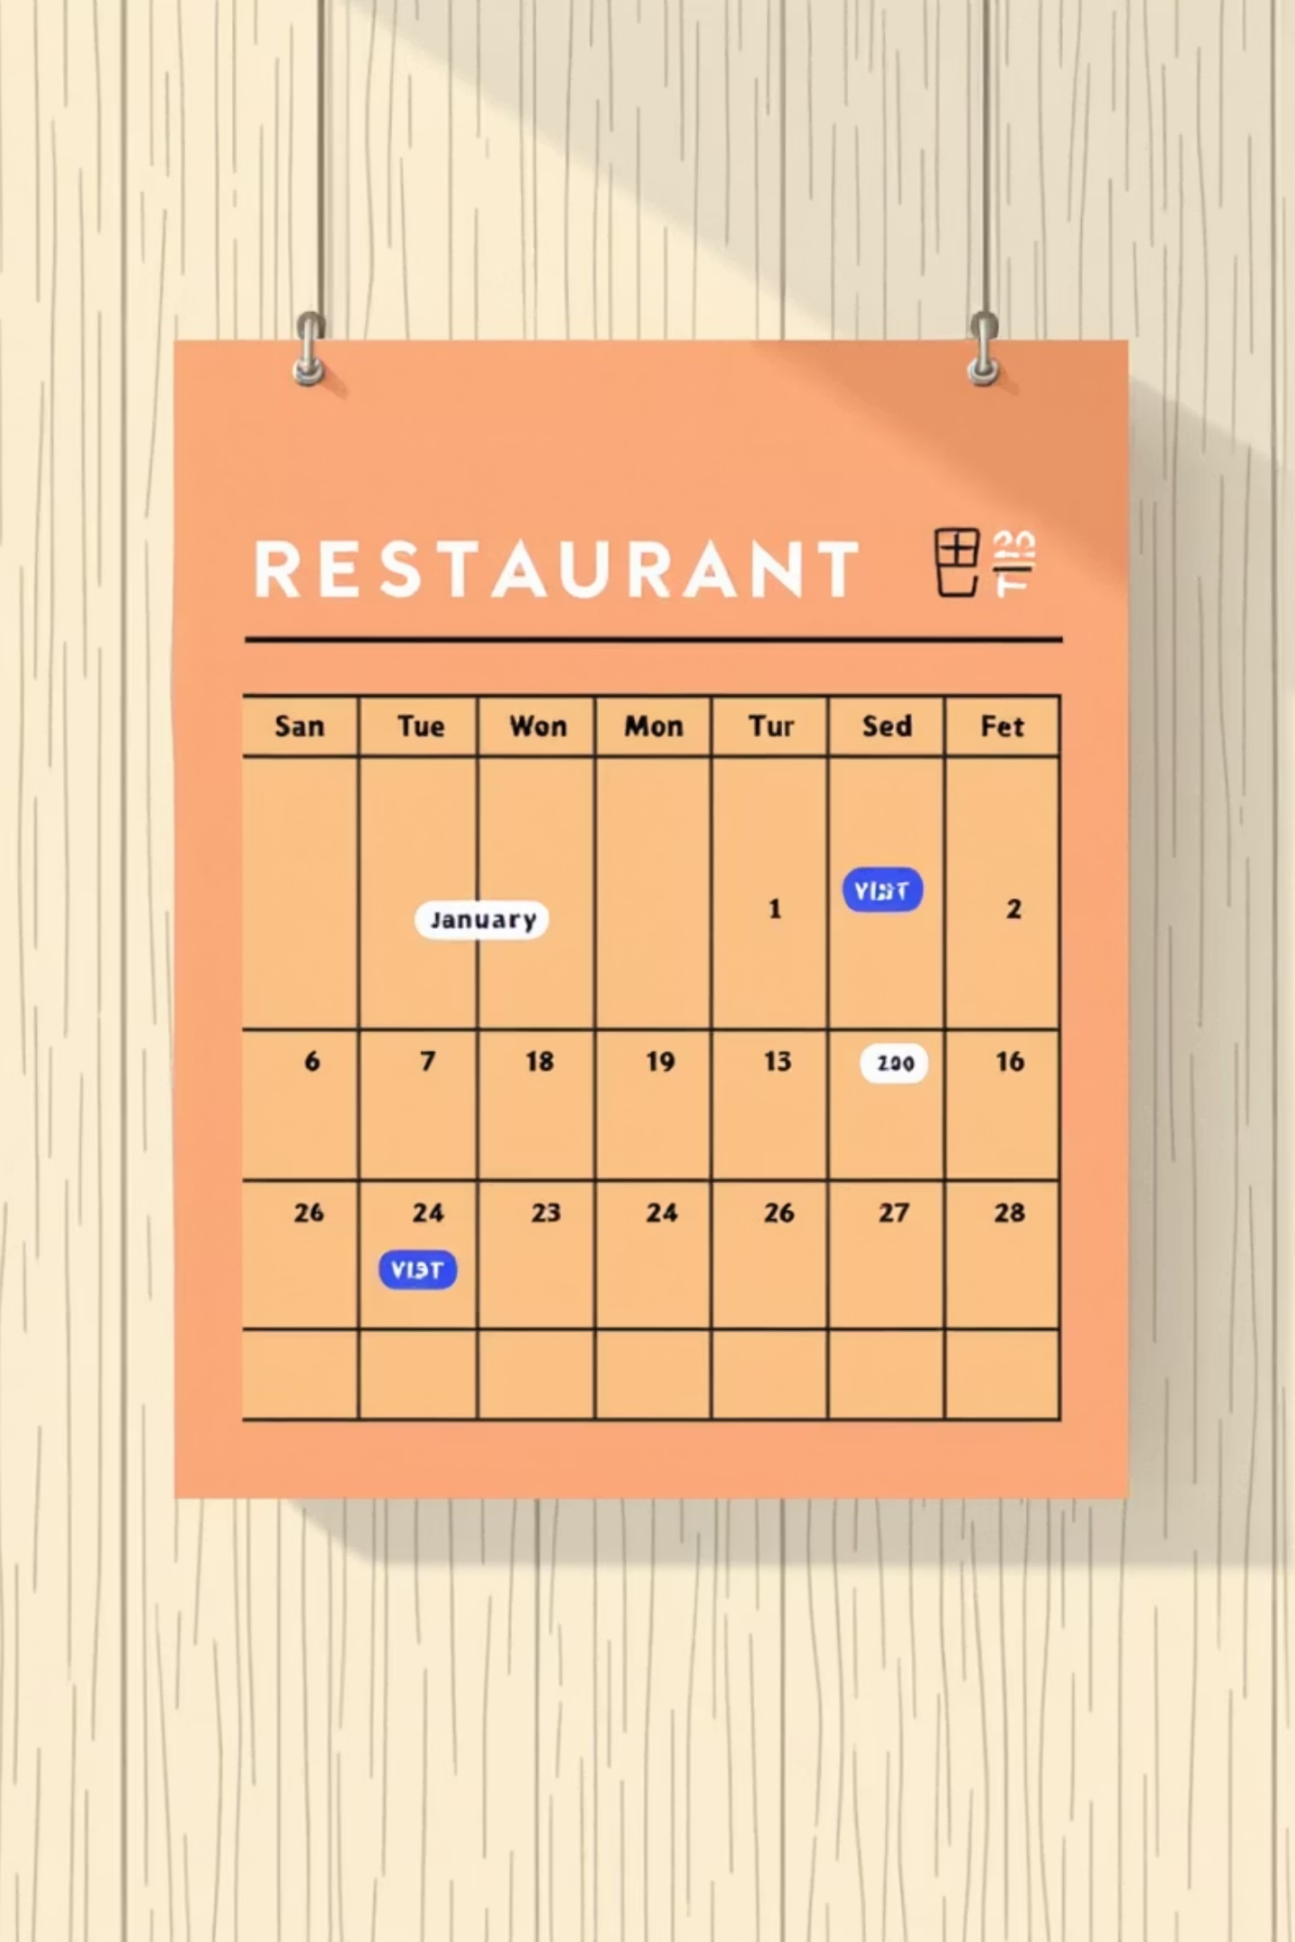
Customer Visit Frequency
4
6
2
Customer A
Customer B
Customer C
Visit days recorded, showing consistent engagement with moderate frequency
Most frequent visitor, demonstrating strong loyalty and regular dining habits
Lowest visit frequency, representing occasional dining behavior
Analysis reveals a strong correlation between visit frequency and total spending - frequent visitors become high-value customers

Slide 7

Favorite Menu Items & Purchase Patterns
Customer A & C
Strong preference for Ramen, showing consistent taste alignment
Customer B
Enjoys all menu items equally, demonstrating adventurous palate
Overall Favorite: Ramen
Most purchased item across all customers, indicating strong menu appeal and consistent quality
First Post-Membership Purchases
Customer A
Customer B
First choice: Curry after joining loyalty program
First choice: Sushi, exploring premium options

Slide 8
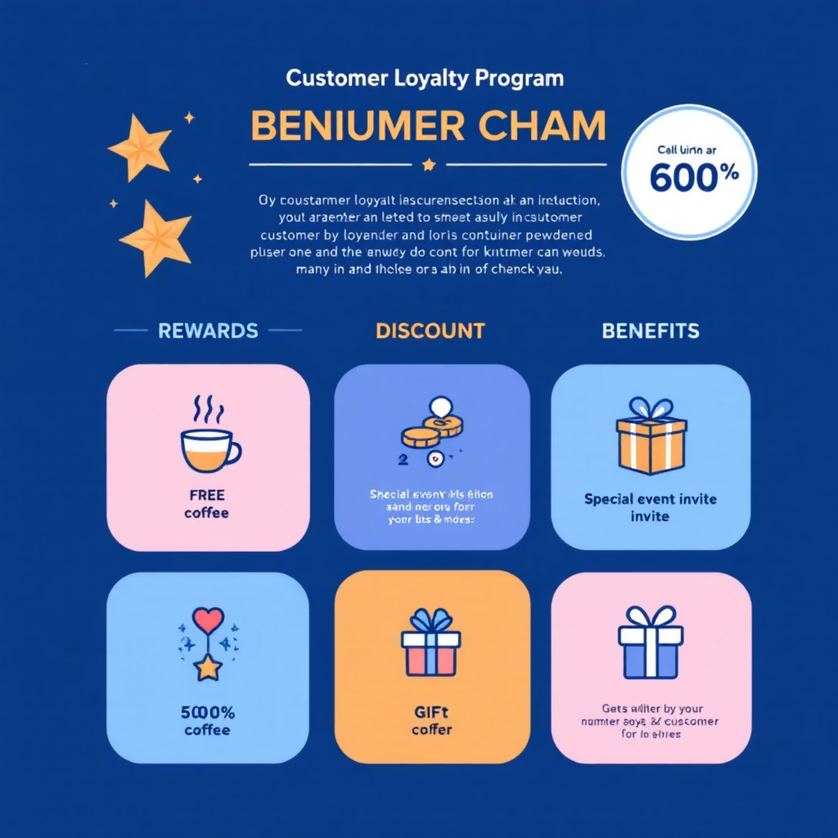
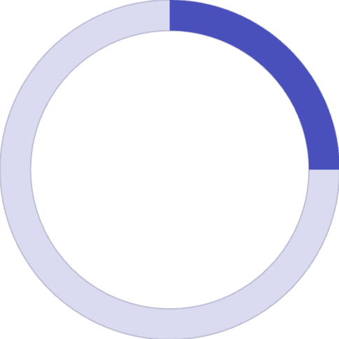
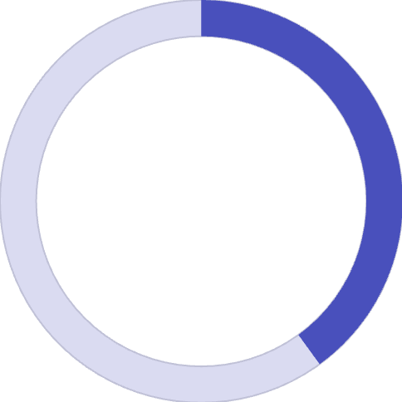

Membership Impact on Purchases
Analyzing orders before and after joining the loyalty program reveals significant behavioral shifts and spending patterns
Pre-Membership Spending
$25
Customer A
2 items purchased before membership
$40
Customer B
2 items purchased before membership
Loyalty program membership encourages increased visit frequency and higher per-visit spending, demonstrating program effectiveness

Slide 9


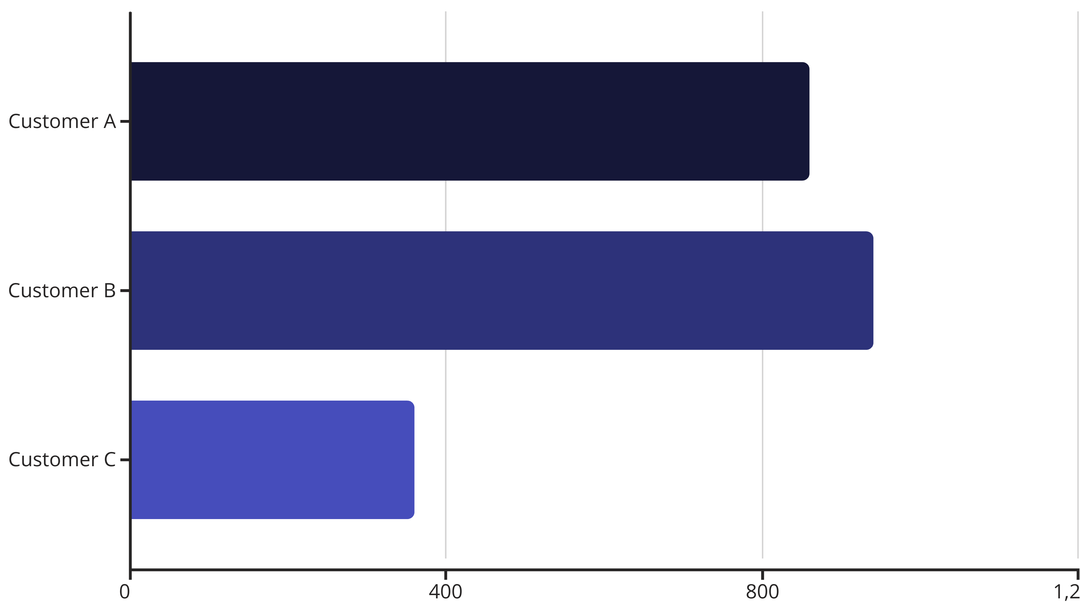
Points System Proposal
Base Rate
Sushi Bonus
Each $1 spent = 10 points for standard menu items
Premium item earns double points: 20 points per $1
Total Points Earned by Customer
Personalized rewards structure motivates continued engagement and can significantly boost customer retention rates

Slide 10





Conclusion & Recommendations
Focus on High-Value Customers
Promote Popular Items
Expand Loyalty Program
Emphasize Ramen and Sushi in marketing campaigns and seasonal specials
Implement tiered points rewards system to increase engagement
Data reveals loyal, high-spending customers who drive revenue growth
Personalize Marketing
Scale with Data
Use visit frequency and spending data for targeted promotions
SQL analysis provides foundation for sustainable, informed growth
"Through strategic data analysis, Danny's Diner transforms from intuition-based decisions to evidence-driven growth"

